Slide 1

HOTTEST VIDEO GAME COMPANY EVER….
By: Ebone’ Smith
Lesson 6 Hands-On

Slide 2

Want to know how well video games are selling?
LET’S LOOK AT THE CHARTS…

Slide 3
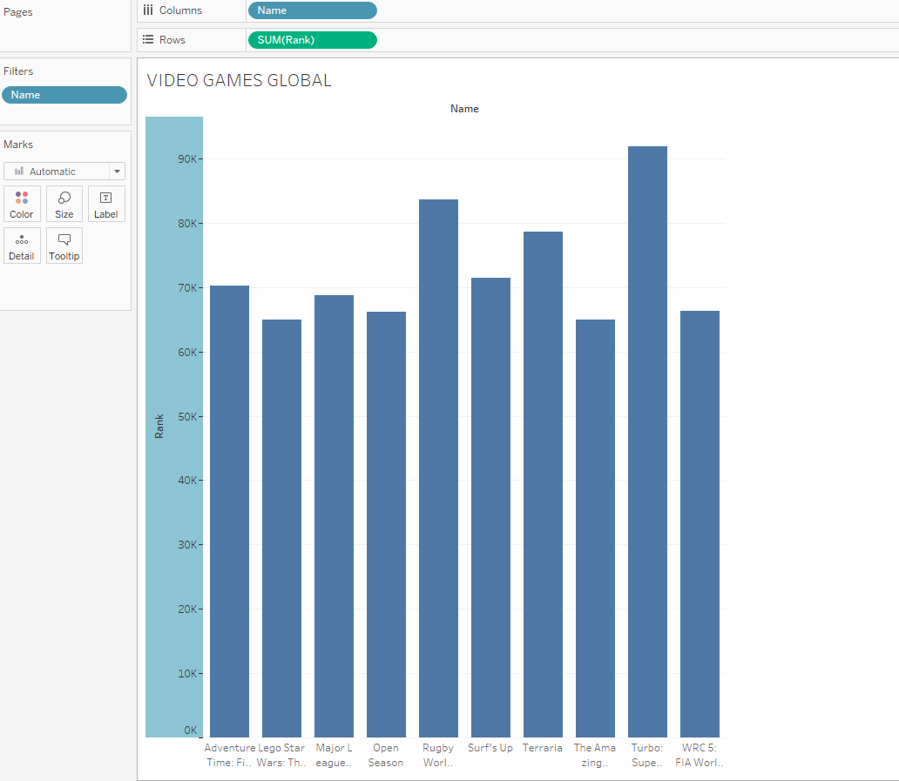
Top 10 VIDEO GAMES TRENDING OVER TIME…

Slide 4
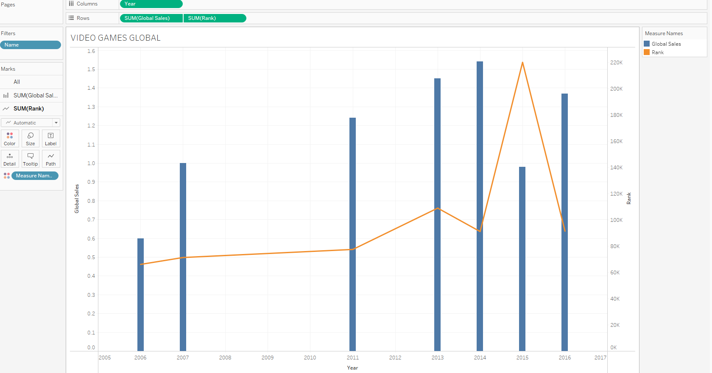
VIDEO GAMES IN GLOBAL SALES and ranking…

Slide 5
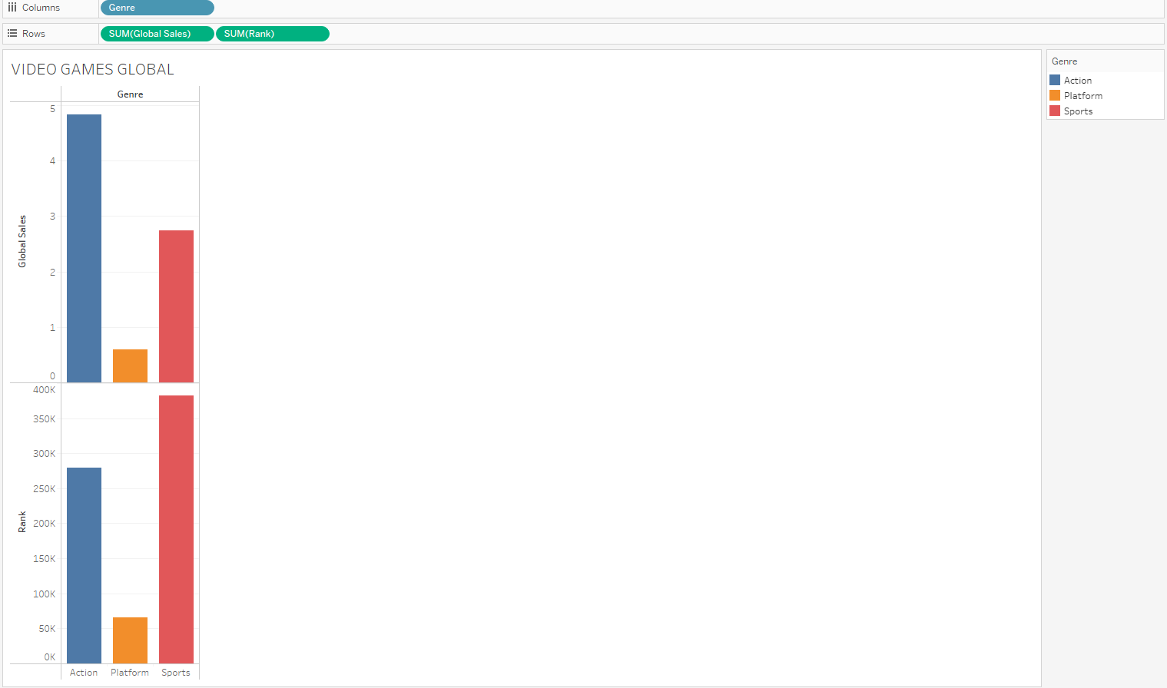
Most popular genre…

Slide 6
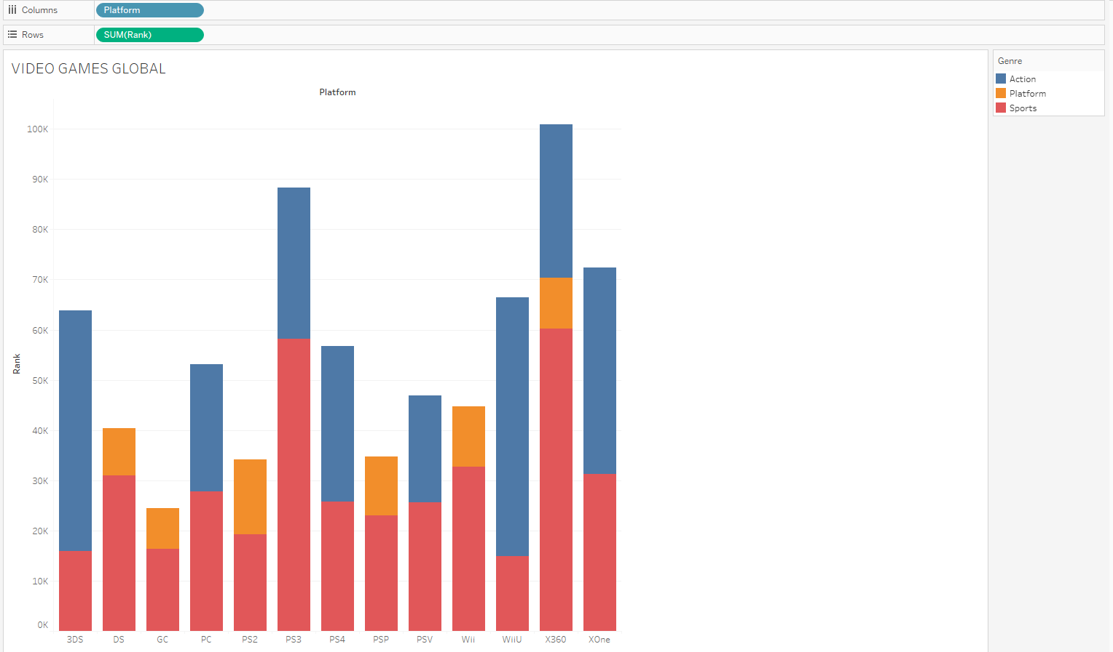
Comparison of video game platforms by genre…

Slide 7
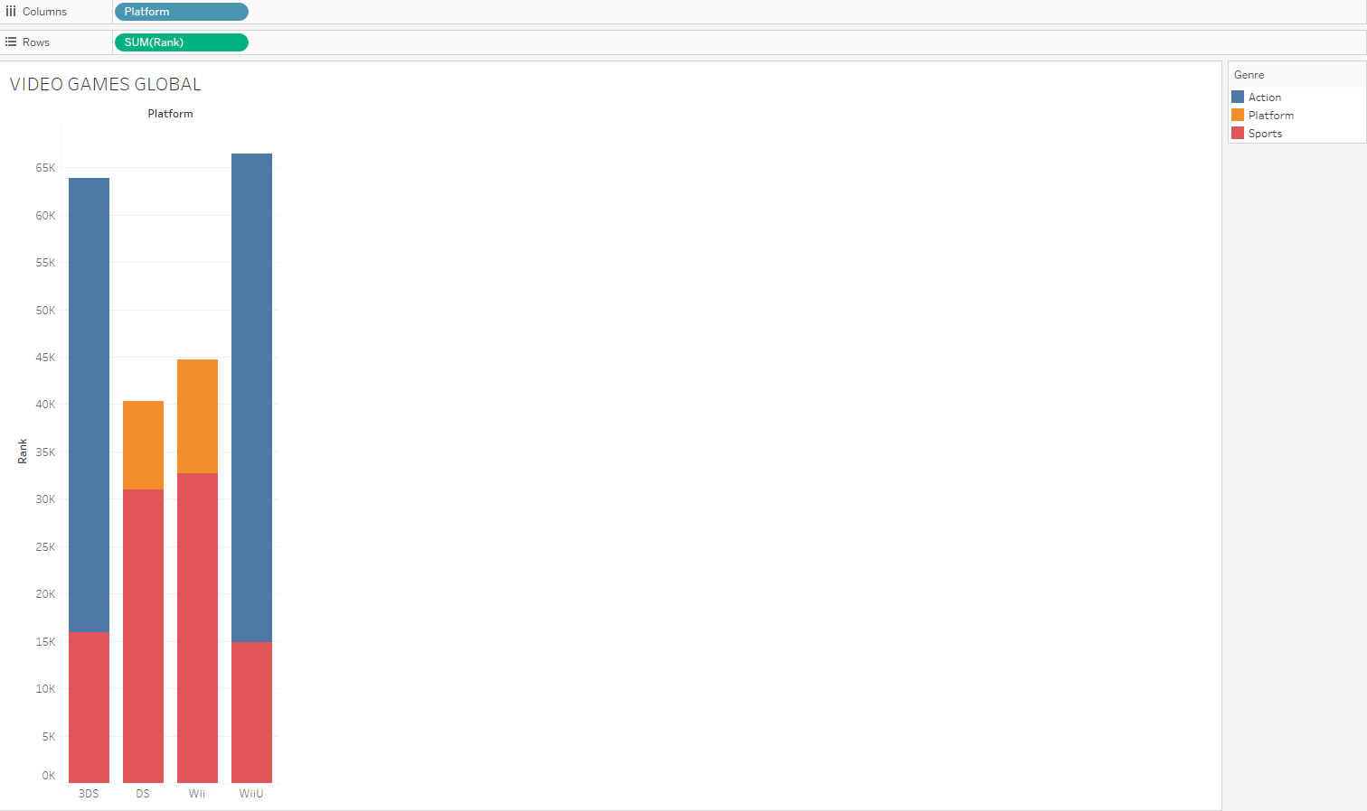
Games for Nintendo fans…

Slide 8
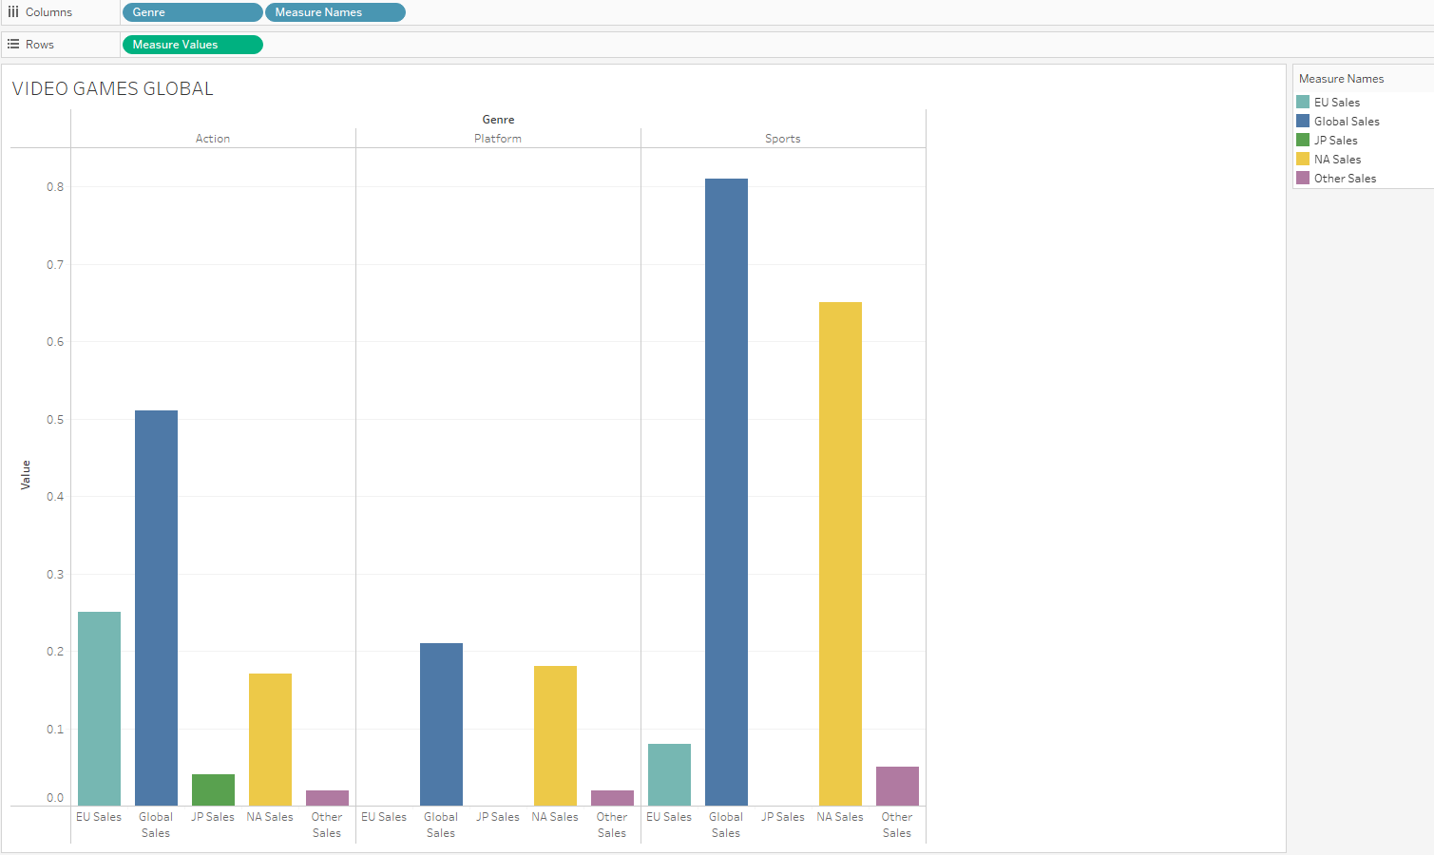
Video games sales around the world…

Slide 9
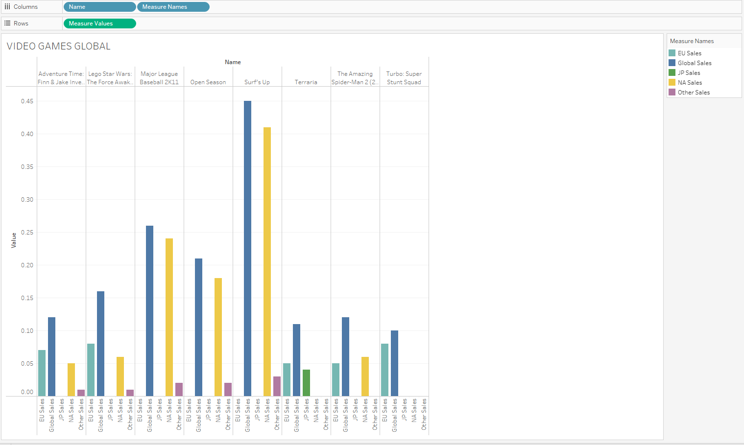
How the top 10 games sold around the world…

Slide 10
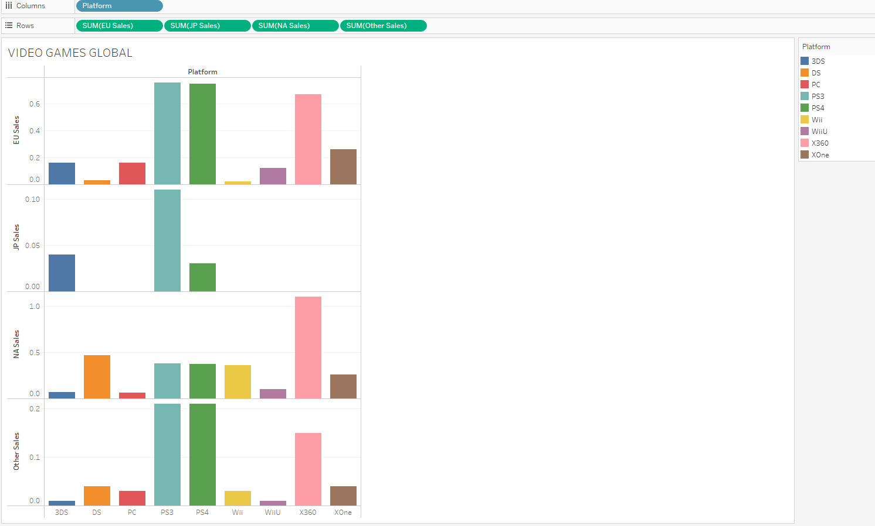
Comparison of which platforms are popular around the world…

